Slide 1
Data Visualization_1
CSE402A
Data Mining
B. Tech. CSE, 2017
Course Leader:
Mohan Kumar K N
mohan.cs.et@msruas.ac.in

Slide 2
Objectives
At the end of this lecture, student will be able to
Describe various visualization techniques
Apply Pixel-oriented, Icon-based, Hierarchical visualization techniques.
Analyze the complex data and relation visualization

Slide 3
Outline
Pixel-oriented visualization techniques
Geometric projection visualization techniques
Icon-based visualization techniques
Hierarchical visualization techniques
Visualizing complex data and relations

Slide 4
Data Visualization
Data visualization
Gain insight into an information space by mapping data onto graphical primitives
Provide qualitative overview of large data sets
Search for patterns, trends, structure, irregularities, relationships among data
Help find interesting regions and suitable parameters for further quantitative analysis
Provide a visual proof of computer representations derived
Categorization of visualization methods:
Pixel-oriented visualization techniques
Geometric projection visualization techniques
Icon-based visualization techniques
Hierarchical visualization techniques
Visualizing complex data and relations

Slide 5
Pixel-Oriented Visualization Techniques
For a data set of m dimensions, create m windows on the screen, one for each dimension
The m dimension values of a record are mapped to m pixels at the corresponding positions in the windows
The colors of the pixels reflect the corresponding values
Income
(b) Credit Limit
(c) transaction volume
(d) age
5
Notes:
5

Slide 6
Laying Out Pixels in Circle Segments
To save space and show the connections among multiple dimensions, space filling is often done in a circle segment
Representing a data record in circle segment
(b) Laying out pixels in circle segment
6
Notes:
6

Slide 7
Geometric Projection Visualization Techniques
Visualization of geometric transformations and projections of the data
Methods
Direct visualization
Scatterplot and scatterplot matrices
Landscapes
Projection pursuit technique: Help users find meaningful projections of multidimensional data
Prosection views
Hyperslice
Parallel coordinates

Slide 8
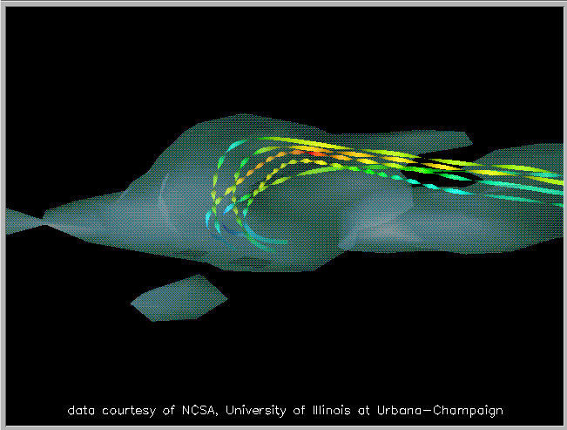
Direct Data Visualization
Ribbons with Twists Based on Vorticity
Notes:
http://books.elsevier.com/companions/1558606890/pictures/Chapter_01/fig1-6b.gif

Slide 9
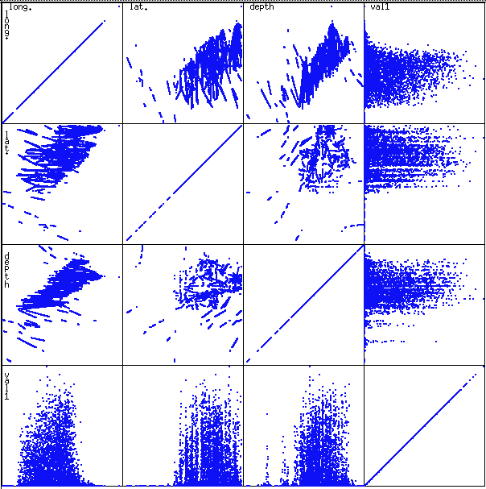
Scatterplot Matrices
Used by ermission of M. Ward, Worcester Polytechnic Institute
Matrix of scatterplots (x-y-diagrams) of the k-dim. data [total of (k2/2-k) scatterplots]

Slide 10
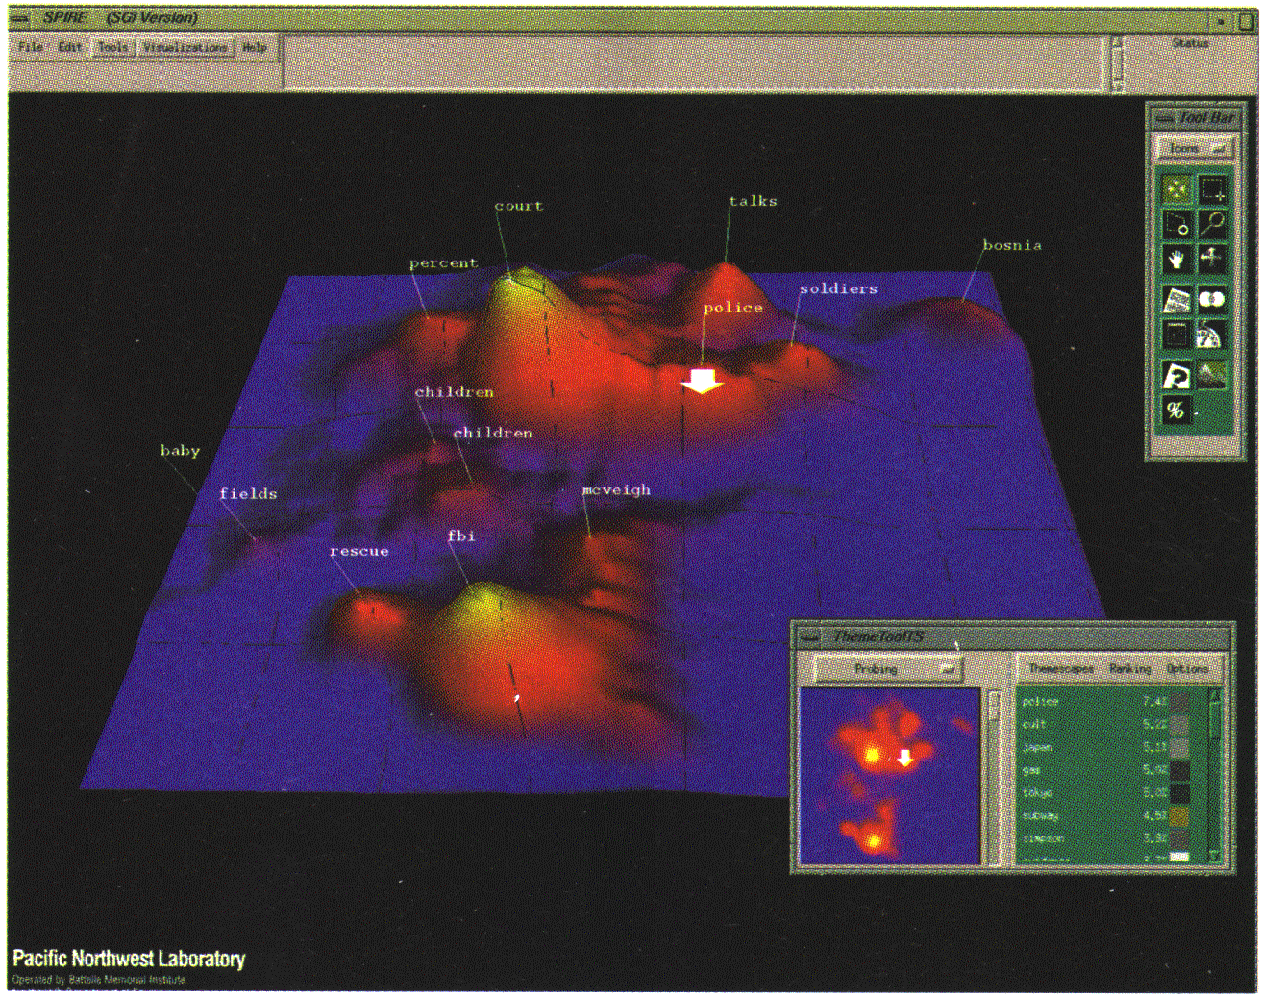
Landscapes
news articles visualized as a landscape
Used by permission of B. Wright, Visible Decisions Inc.
Visualization of the data as perspective landscape
The data needs to be transformed into a (possibly artificial) 2D spatial representation which preserves the characteristics of the data

Slide 11
Parallel Coordinates
n equidistant axes which are parallel to one of the screen axes and correspond to the attributes
The axes are scaled to the [minimum, maximum]: range of the corresponding attribute
Every data item corresponds to a polygonal line which intersects each of the axes at the point which corresponds to the value for the attribute

Slide 12
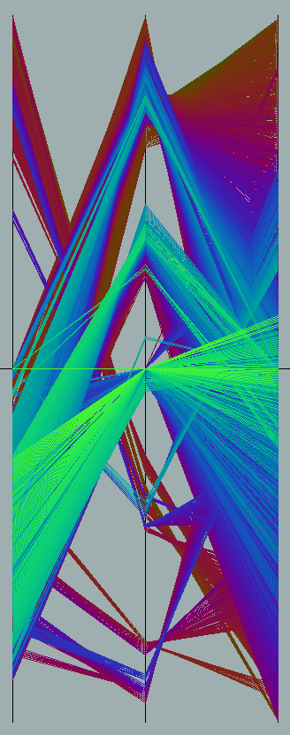
Parallel Coordinates of a Data Set

Slide 13
Icon-Based Visualization Techniques
Visualization of the data values as features of icons
Typical visualization methods
Chernoff Faces
Stick Figures
General techniques
Shape coding: Use shape to represent certain information encoding
Color icons: Use color icons to encode more information
Tile bars: Use small icons to represent the relevant feature vectors in document retrieval

Slide 14
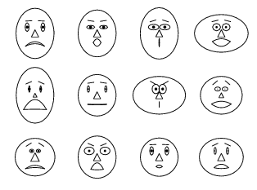
Chernoff Faces
A way to display variables on a two-dimensional surface, e.g., let x be eyebrow slant, y be eye size, z be nose length, etc.
The figure shows faces produced using 10 characteristics--head eccentricity, eye size, eye spacing, eye eccentricity, pupil size, eyebrow slant, nose size, mouth shape, mouth size, and mouth opening): Each assigned one of 10 possible values, generated using Mathematica (S. Dickson)
REFERENCE: Gonick, L. and Smith, W. The Cartoon Guide to Statistics. New York: Harper Perennial, p. 212, 1993
Weisstein, Eric W. "Chernoff Face." From MathWorld--A Wolfram Web Resource. mathworld.wolfram.com/ChernoffFace.html

Slide 15
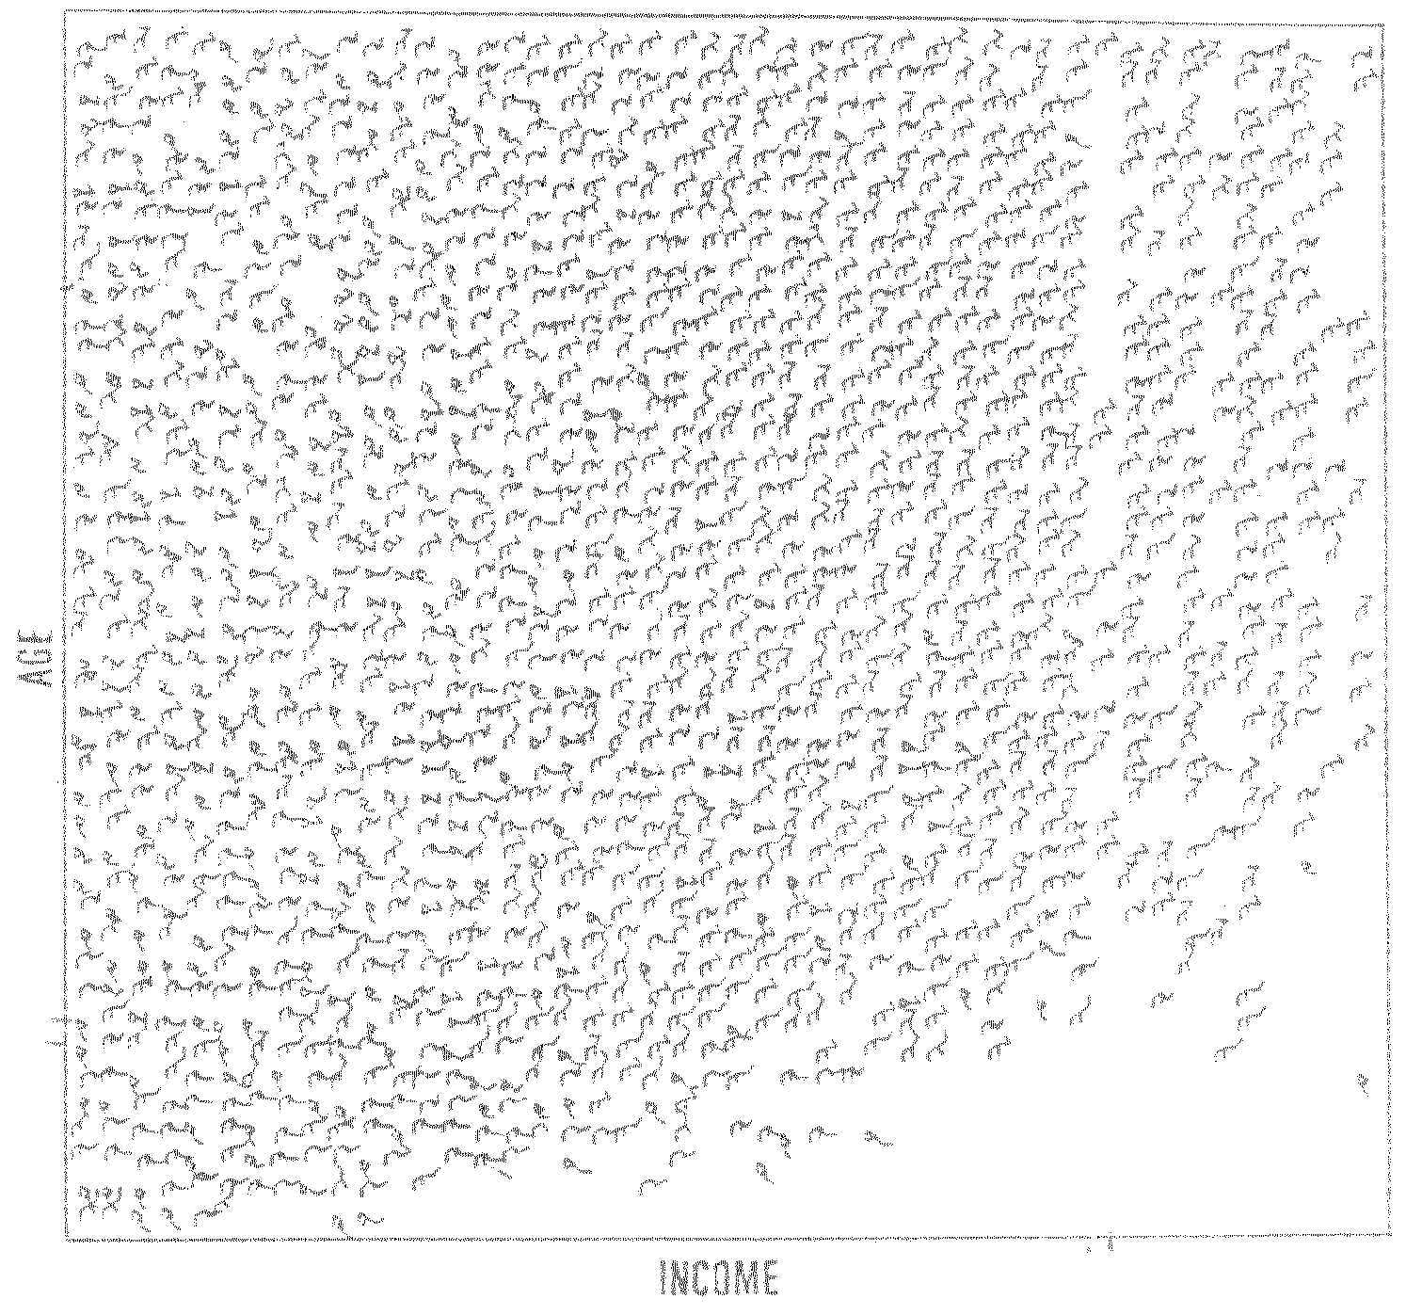
Stick Figure
A census data figure showing age, income, gender, education, etc.
used by permission of G. Grinstein, University of Massachusettes at Lowell
A 5-piece stick figure (1 body and 4 limbs w. different angle/length)
Two attributes mapped to axes, remaining attributes mapped to angle or length of limbs”. Look at texture pattern

Slide 16
Hierarchical Visualization Techniques
Visualization of the data using a hierarchical partitioning into subspaces
Methods
Dimensional Stacking
Worlds-within-Worlds
Tree-Map
Cone Trees
InfoCube

Slide 17
Dimensional Stacking
Partitioning of the n-dimensional attribute space in 2-D subspaces, which are ‘stacked’ into each other
Partitioning of the attribute value ranges into classes. The important attributes should be used on the outer levels.
Adequate for data with ordinal attributes of low cardinality
But, difficult to display more than nine dimensions
Important to map dimensions appropriately

Slide 18
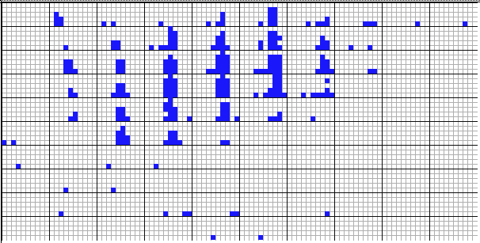
Dimensional Stacking
Used by permission of M. Ward, Worcester Polytechnic Institute
Visualization of oil mining data with longitude and latitude mapped to the outer x-, y-axes and ore grade and depth mapped to the inner x-, y-axes

Slide 19
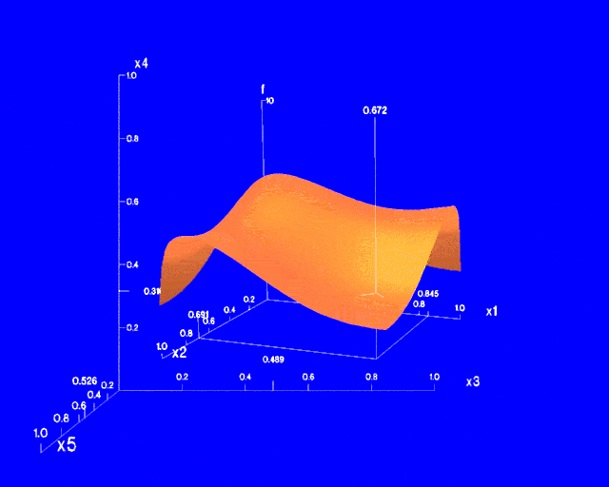
Worlds-within-Worlds
Assign the function and two most important parameters to innermost world
Fix all other parameters at constant values - draw other (1 or 2 or 3 dimensional worlds choosing these as the axes)
Software that uses this paradigm
N–vision: Dynamic interaction through data glove and stereo displays, including rotation, scaling (inner) and translation (inner/outer)
Auto Visual: Static interaction by means of queries

Slide 20
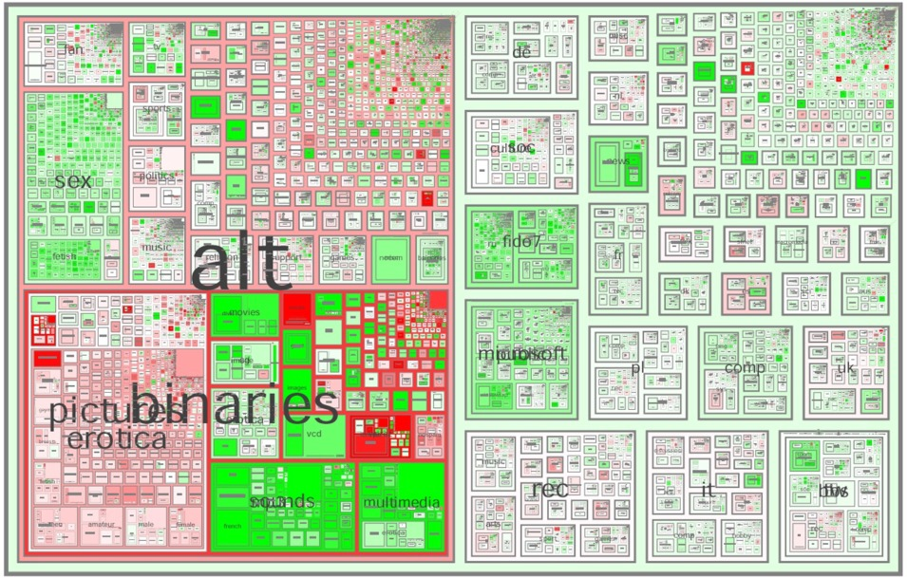
Tree-Map
Screen-filling method which uses a hierarchical partitioning of the screen into regions depending on the attribute values
The x- and y-dimension of the screen are partitioned alternately according to the attribute values (classes)
MSR Netscan Image
Ack.: http://www.cs.umd.edu/hcil/treemap-history/all102001.jpg

Slide 21
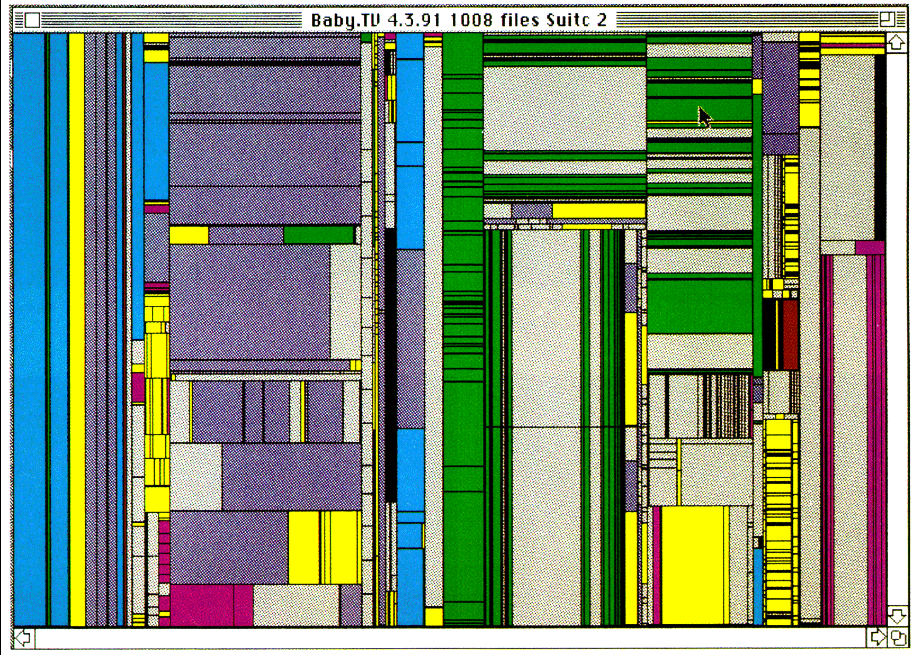
Tree-Map of a File System (Schneiderman)

Slide 22
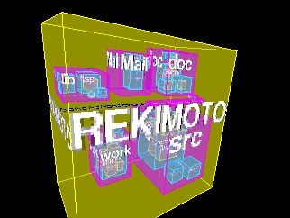
InfoCube
A 3-D visualization technique where hierarchical information is displayed as nested semi-transparent cubes
The outermost cubes correspond to the top level data, while the subnodes or the lower level data are represented as smaller cubes inside the outermost cubes, and so on

Slide 23
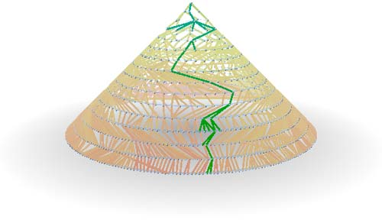
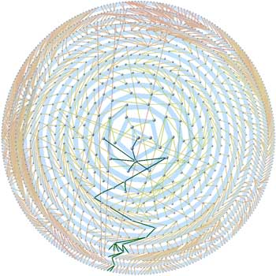
Three-D Cone Trees
3D cone tree visualization technique works well for up to a thousand nodes or so
First build a 2D circle tree that arranges its nodes in concentric circles centered on the root node
Cannot avoid overlaps when projected to 2D
G. Robertson, J. Mackinlay, S. Card. “Cone Trees: Animated 3D Visualizations of Hierarchical Information”, ACM SIGCHI'91
Graph from Nadeau Software Consulting website: Visualize a social network data set that models the way an infection spreads from one person to the next
Ack.: http://nadeausoftware.com/articles/visualization

Slide 24
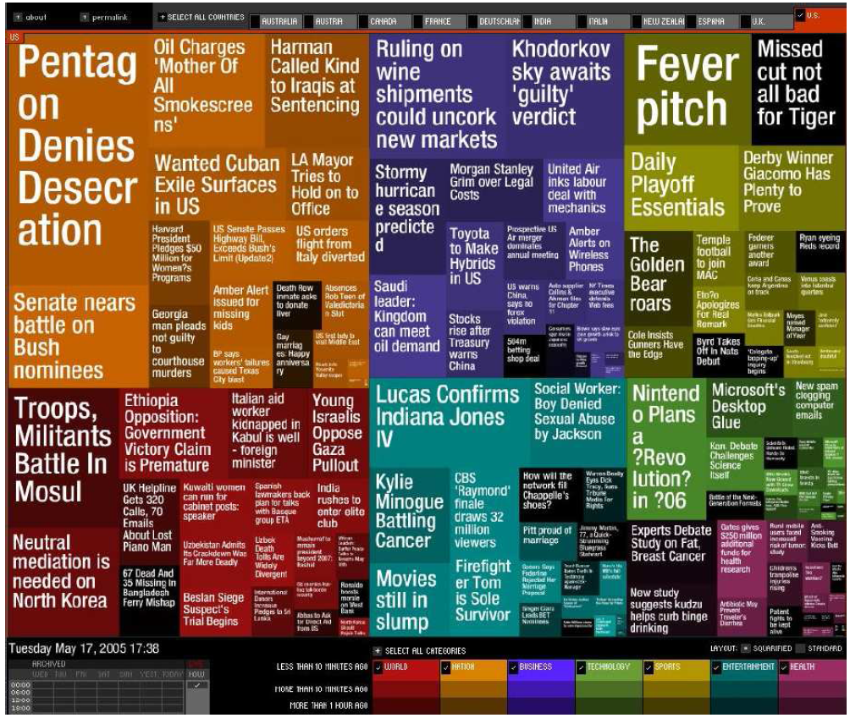
Visualizing Complex Data and Relations
Visualizing non-numerical data: text and social networks
Tag cloud: visualizing user-generated tags
The importance of tag is represented by font size/color
Besides text data, there are also methods to visualize relationships, such as visualizing social networks
Newsmap: Google News Stories in 2005

Slide 25
Summary
Data attribute types: nominal, binary, ordinal, interval-scaled, ratio-scaled
Many types of data sets, e.g., numerical, text, graph, Web, image.
Gain insight into the data by:
Basic statistical data description: central tendency, dispersion, graphical displays
Data visualization: map data onto graphical primitives
Measure data similarity
Above steps are the beginning of data preprocessing.
Many methods have been developed but still an active area of research.

Slide 26
Reference
a. Essential Reading
1. Class Notes
2. Bramer, M. (2007) Principles of Data Mining. Springer
b. Recommended Reading
1. Torgo, L. (2011) Data Mining with R: Learning with Case Studies. Chapman & Hall
2. Kecman, V. (2001) Learning and Soft Computing. The MIT Press
3. Witten, I. H., Frank, E., and Hall, M. A. (2011) Data Mining: Practical Machine Learning
Tools and Techniques, 3rd edn. Morgan Kaufmann

